Slide 1

Title
Clustering in Unsupervised Learning
Chapter 3 – Introduction to Machine Learning with Python CSC 564 – Spring 2026
Presenters:​
Fares Al-Otaibi
447910034
Faisal Al-Shayie 447910626
Omar Ateen 447910539
CSC564— King Saud University
1

Slide 2
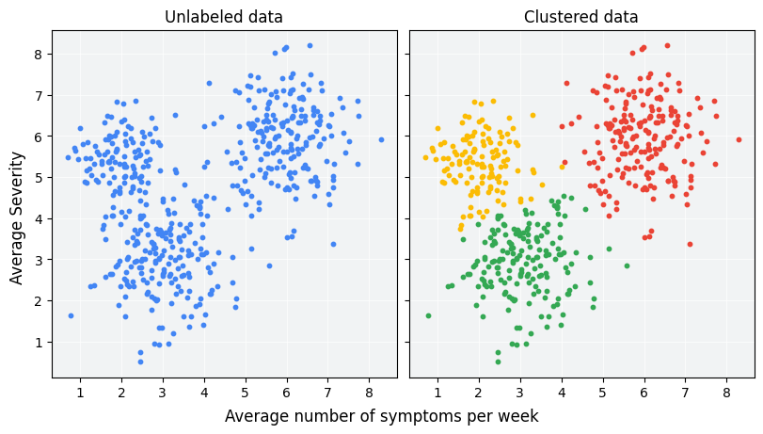
What is Clustering?
1
Unsupervised learning technique
2
Groups similar data points
3
No labeled data
4
Reveals hidden structure
CSC564— King Saud University
2

Slide 3
Clustering Approaches
Clustering
Hierarchical
Agglomerative
Density-Based
DBSCAN
Partitional
K-Means
CSC564— King Saud University
3

Slide 4
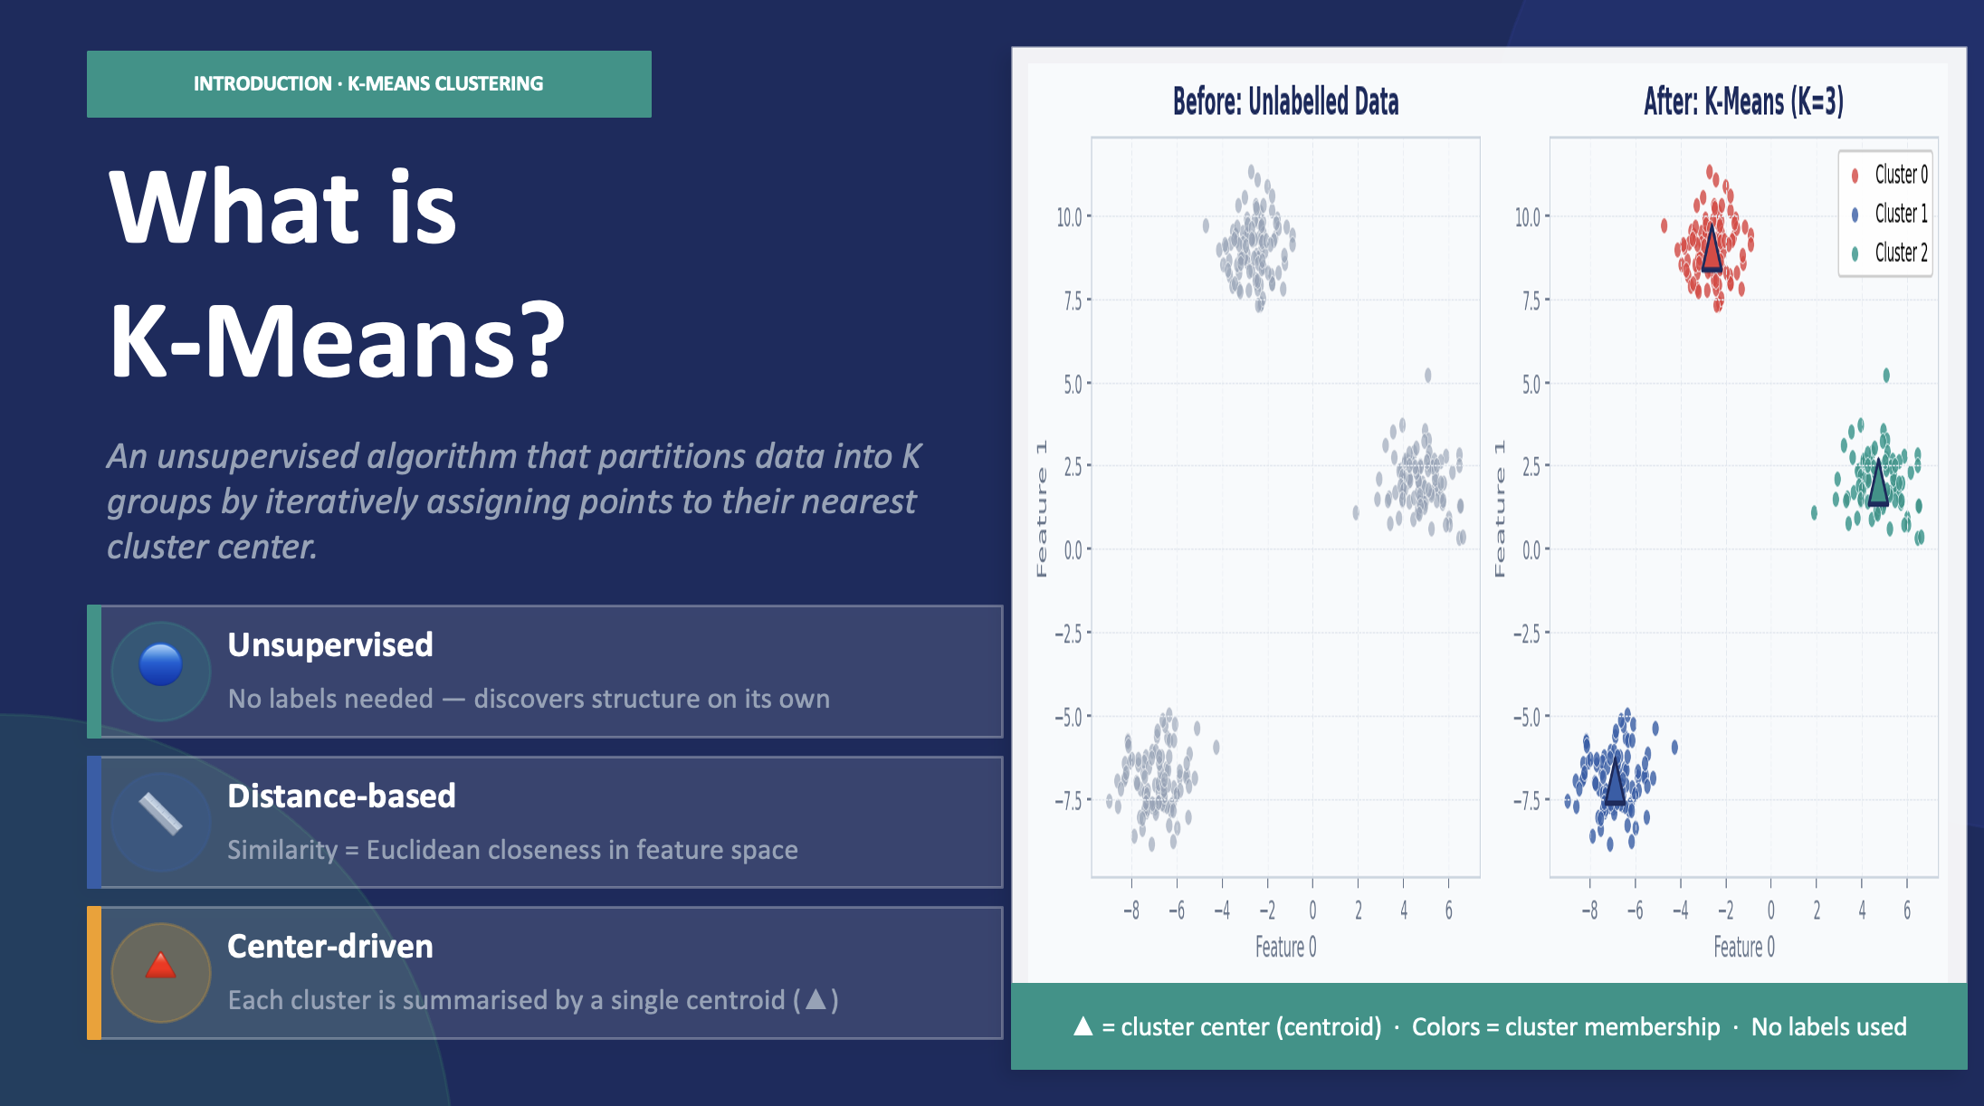
What is K-Mean
Click to add content
CSC564— King Saud University
4

Slide 5
The K-Means Algorithm
An iterative two-step process that alternates until convergence
1
Initialization
2
Assign Points
Randomly select K data points as the initial cluster centers (triangles). This is the starting point — the centers are placed arbitrarily in the data space.
Each data point is assigned to the closest cluster center using Euclidean distance. Points of the same color belong to the same cluster.
3
Recompute Centers
4
Repeat Until Convergence
Each cluster center is moved to the mean (average position) of all data points currently assigned to it. The triangle shifts to the centroid.
Steps 2 and 3 are repeated. After the 3rd iteration in the book example, assignments no longer change — the algorithm stops.
⚡ Algorithm stops when cluster assignments no longer change between iterations — this is called convergence.
CSC564— King Saud University
5

Slide 6
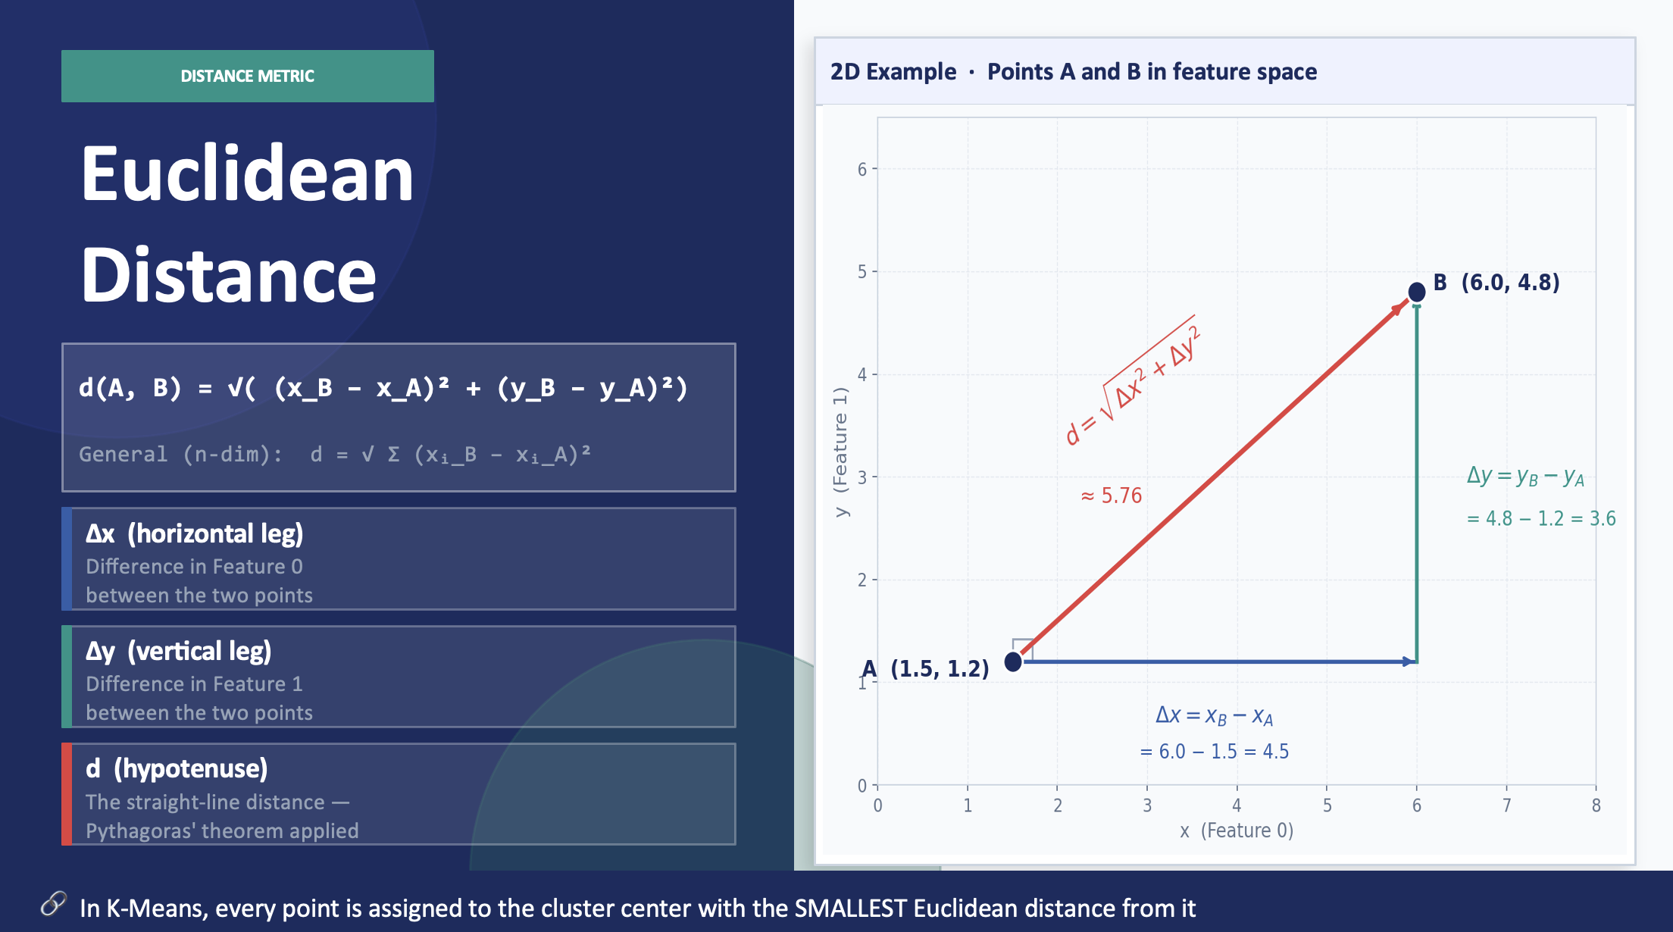
Dist.
Click to add content
CSC564— King Saud University
6

Slide 7
Applying K-Means with scikit-learn
Fitting the model, reading labels, and predicting new points
Python • scikit-learn
make_blobs()
from sklearn.datasets import make_blobs from sklearn.cluster import KMeans # Generate synthetic data X, y = make_blobs(random_state=1) # Build the clustering model kmeans = KMeans(n_clusters=3) kmeans.fit(X) # Access cluster labels print(kmeans.labels_)
Generates synthetic 2D cluster data for testing. random_state=1 ensures reproducibility.
KMeans(n_clusters=3)
Instantiates the model. We specify K=3. Default is 8 — there's no magic default for K.
.fit(X)
Runs the iterative algorithm on training data. Cluster centers stored in cluster_centers_.
.labels_
Array of integers (0 to K-1) for each training point indicating its cluster membership.
Using .predict() on New Data
kmeans.predict(X_new) — New points are assigned to the nearest cluster center without modifying the model. Calling predict on training data returns the same result as .labels_
CSC564— King Saud University
7

Slide 8
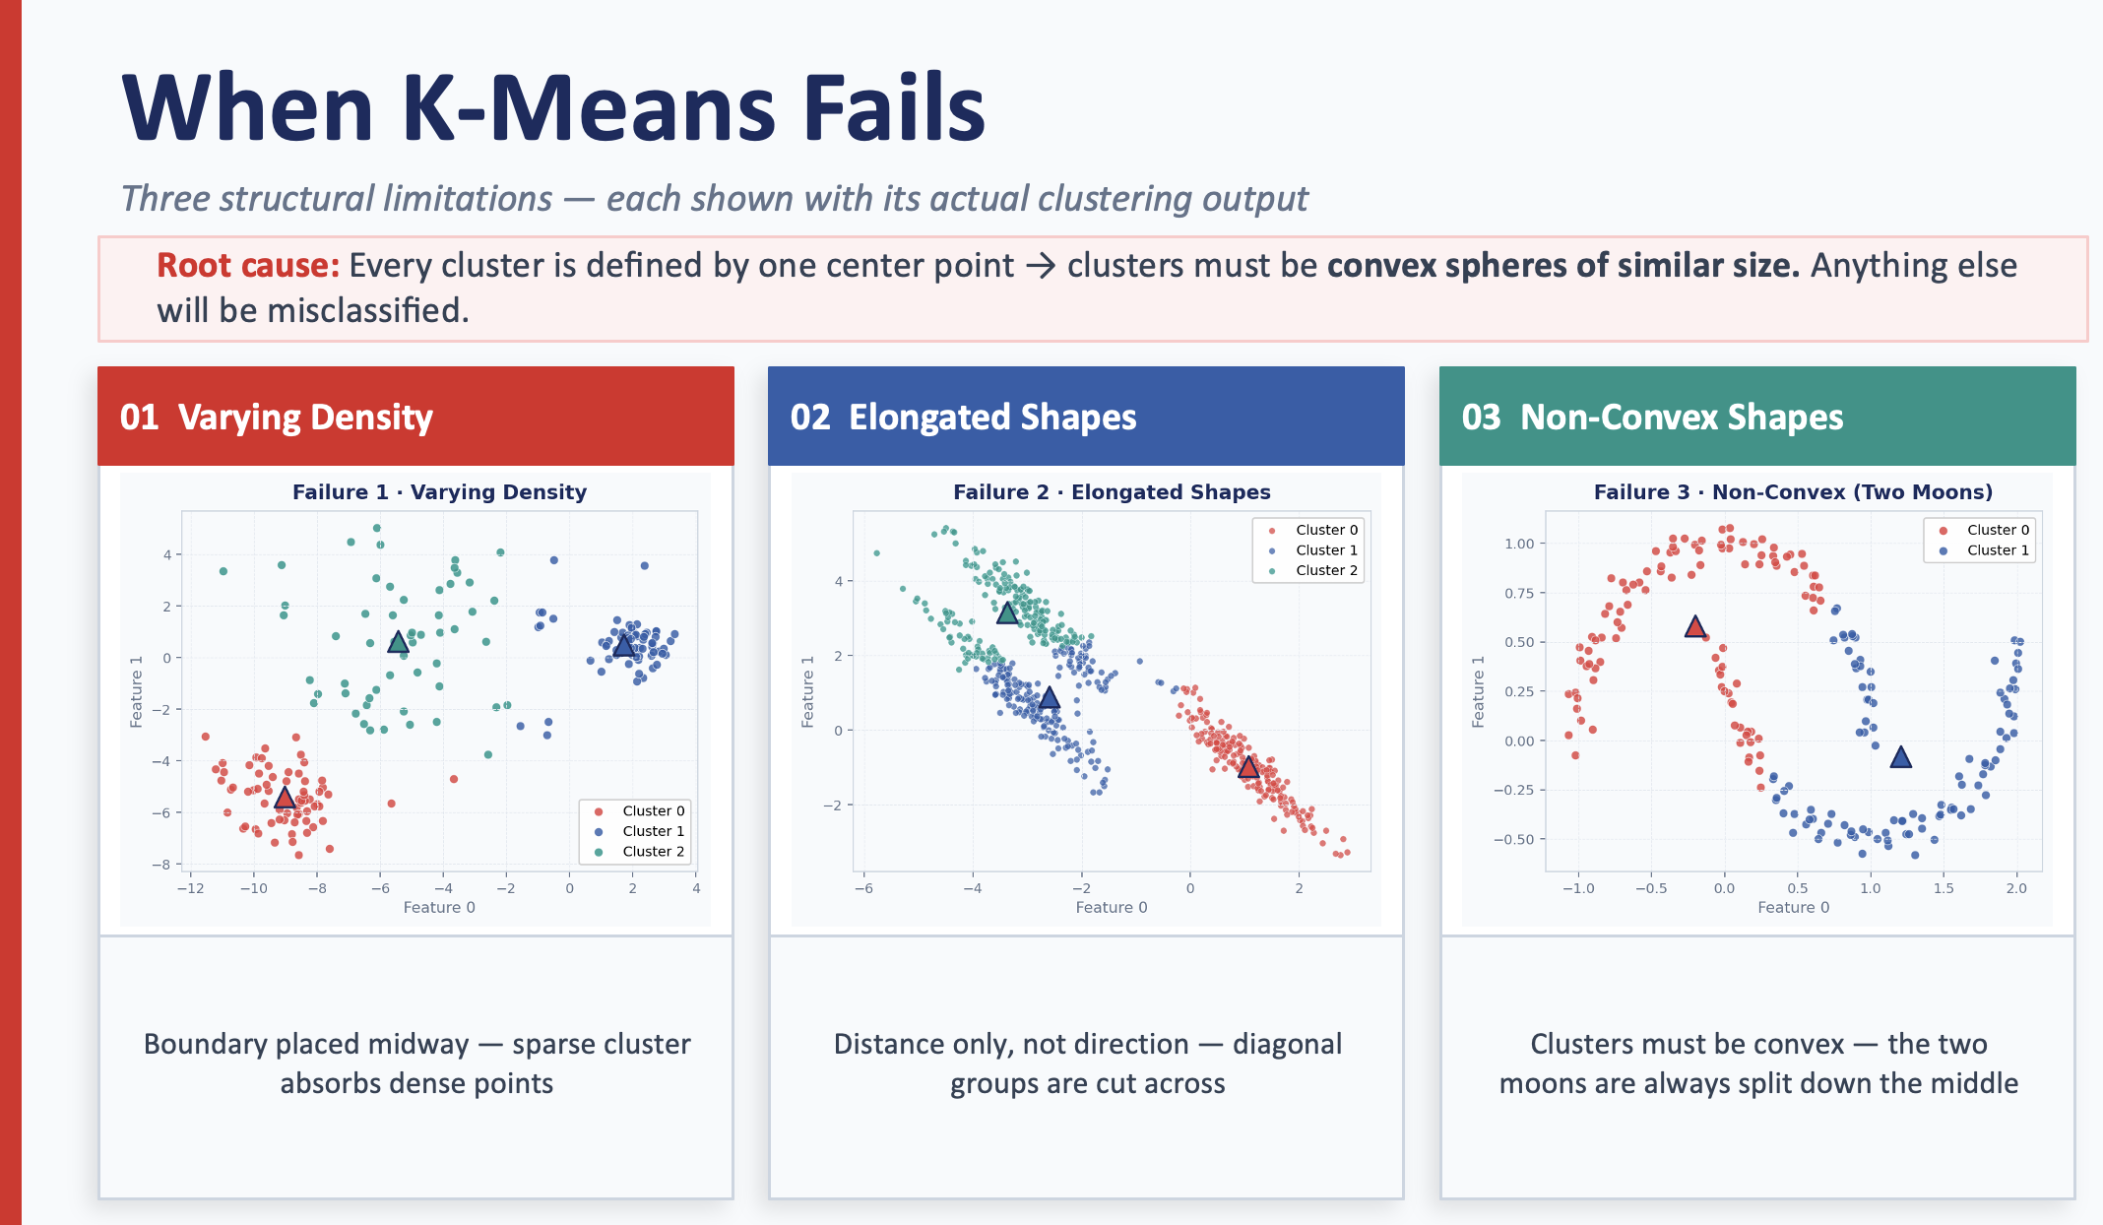
CSC564— King Saud University

Slide 9
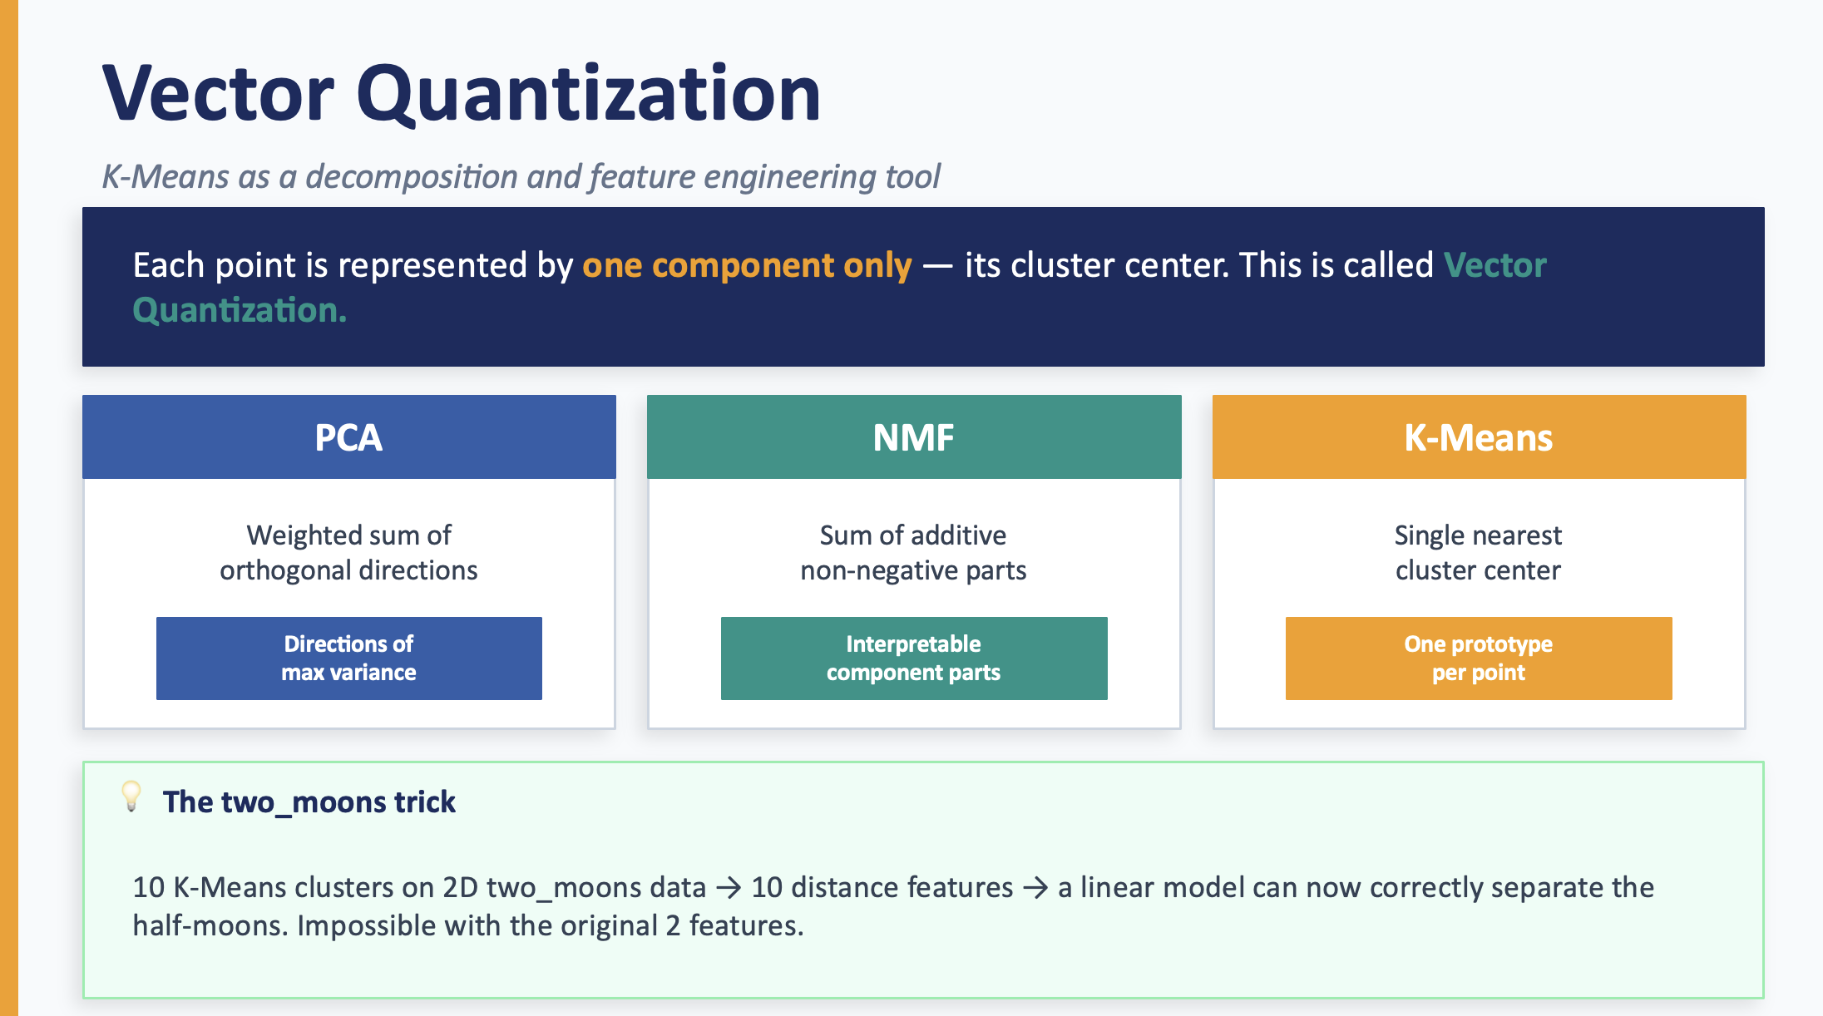
CSC564— King Saud University
9

Slide 10
Strengths, Weaknesses & Practical Tips
What to consider before applying K-Means in practice
✅ STRENGTHS
❌ WEAKNESSES
Simple and intuitive to understand and implement
Requires specifying K upfront — often unknown in real-world problems
Scales well to large datasets (MiniBatchKMeans for very large data)
Random initialization means different runs can give different results
Runs relatively quickly — efficient O(nkI) time complexity
Assumes convex, spherical clusters of similar size and density
Useful as a preprocessing/feature engineering step (vector quantization)
Struggles with elongated, non-spherical, or complex-shaped clusters
scikit-learn runs 10 random initializations by default and picks the best
Sensitive to outliers — they can pull cluster centers away significantly
💡 When K-means fails on complex shapes, consider DBSCAN or Agglomerative Clustering — covered next in Chapter 3!
CSC564— King Saud University
10

Slide 11
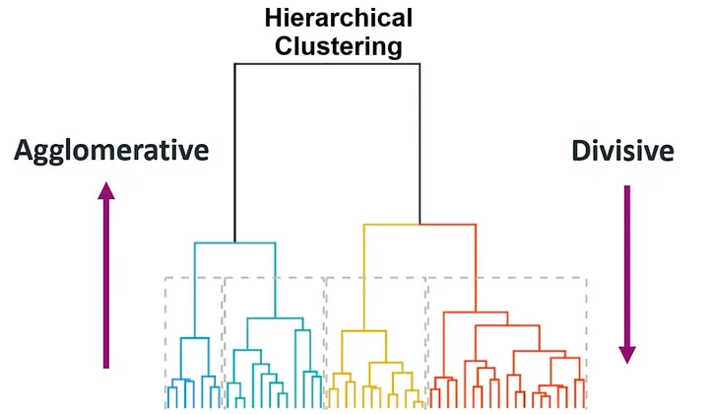
Hierarchical Clustering
What Is It?
Builds a hierarchy of clusters
Produces a tree structure (dendrogram)
Two types:
Agglomerative (bottom-up)
Divisive (top-down)
CSC564— King Saud University
11

Slide 12
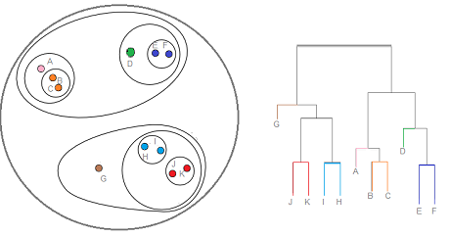
Why Agglomerative Clustering?
1
Does not rely on random initialization
2
Helps with choosing the number of clusters
3
Produces a hierarchical clustering (dendrogram)
4
Useful for small datasets
CSC564— King Saud University
12

Slide 13

Agglomerative Algorithm Steps
Initialize each point as a separate cluster
Compute pairwise distance matrix
Merge the two closest clusters
Update distances
Repeat until one cluster remains
CSC564— King Saud University
13

Slide 14
Linkage Criteria
1
Ward
2
Complete Link
Merges clusters that minimize the increase in within-cluster variance
Similar behavior to K-Means
Prefers spherical, compact clusters
Works well when clusters are similar in size
Distance between clusters = maximum pairwise distance
Produces compact clusters
Avoids long “chain” structures
Sensitive to outliers
3
Average Link
Distance between clusters = mean pairwise distance
Balanced behavior
Less sensitive to extreme points
Often produces stable cluster shapes
CSC564— King Saud University
14

Slide 15
Important Properties of Agglomerative Clustering
No cluster centers computed
No .predict() method
Sensitive to linkage choice
Can use connectivity constraint
Requires full distance matrix (O(n²))
CSC564— King Saud University
15

Slide 16
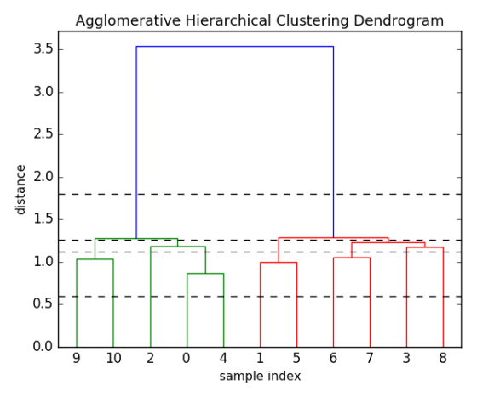
Dendrogram
A tree-like diagram that records the sequence of merges. The vertical axis represents the distance at which clusters were joined.
Choosing the number of clusters is as simple as drawing a horizontal line through the tree.
CSC564— King Saud University
16

Slide 17
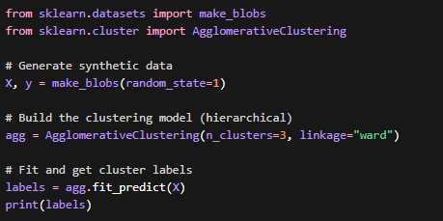
Applying Agglomerative Clustering
Fitting the model and reading cluster labels (hierarchical approach)
make_blobs()
Generates synthetic sample data for clustering. random_state ensures reproducibility.
AgglomerativeClustering(n_clusters=3, linkage="ward")
Creates a hierarchical (bottom-up) clustering model.
n_clusters: number of final clusters
linkage: strategy used to merge clusters
"ward" → minimizes variance
"complete" → max distance
"average" → mean distance
.fit_predict(X)
Performs hierarchical merging and returns cluster labels in one step.
.labels_
Array of cluster assignments (one label per data point).
CSC564— King Saud University
17

Slide 18
Strengths & Weaknesses
✅ STRENGTHS
❌ WEAKNESSES
No need to predefine K
(n²) complexity
Hierarchical representation
Not scalable
Useful for small datasets
Sensitive to noise
CSC564— King Saud University
18

Slide 19
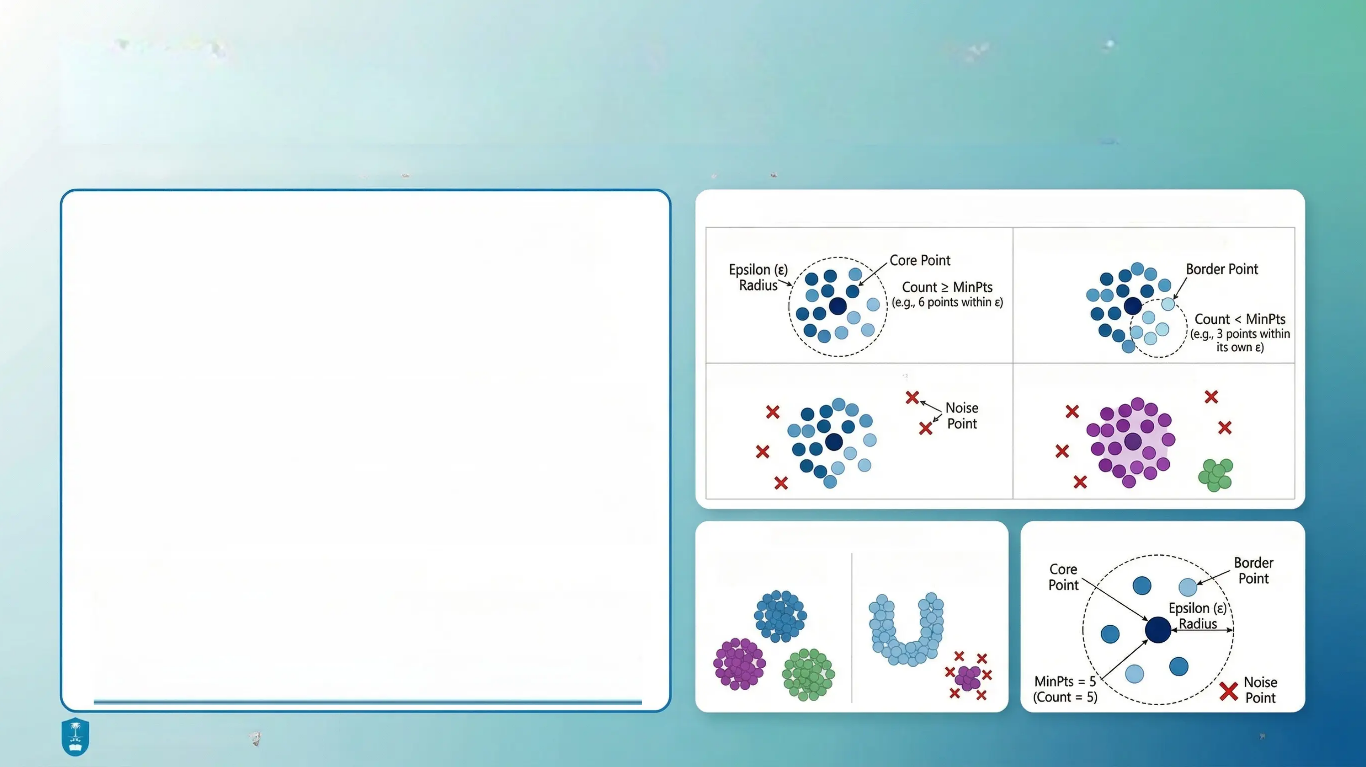
DBSCAN: Density-Based Spatial Clustering of Applications with Noise
A density-based clustering algorithm that finds arbitrarily shaped clusters and handles noise.
• Density-Based Clustering Approach: DBSCAN identifies clusters as dense regions separated by areas of lower point density.
• No Pre-defined Cluster Count: Unlike k-means, DBSCAN automatically determines the number of clusters from data density patterns
• Handles Non-Spherical Clusters: Capable of discovering clusters with arbitrary shapes beyond just circular or elliptical forms.
• Noise Point Identification: Effectively identifies and labels outliers as noise points rather than forcing them into clusters.
• Based on Two Key Parameters:
▪ Epsilon (ε): Neighborhood radius defining the scope of influence for each point. ▪ MinPts: Minimum number of points required within the epsilon radius to form a dense region.
CSC564— King Saud University
19
King Saud University
CSC 564 - Spring 2026

Slide 20
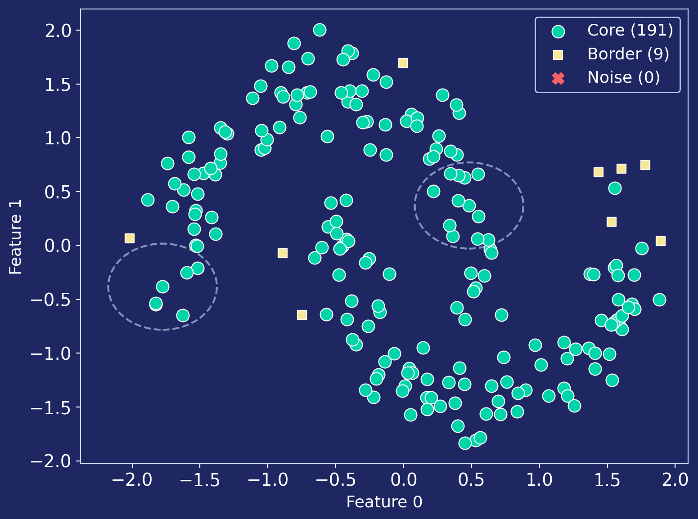
DBSCAN — Core Concept
Find dense regions separated by sparse areas
eps (ε)
Neighborhood radius — how far to look for neighbors
min_samples
Minimum neighbors needed to be a dense region
Three Point Types
Core ≥ min_samples neighbors
Border < min_samples neighbors
Noise Not near any core point
CSC582 — King Saud University
4 / 14
CSC564— King Saud University
20

Slide 21
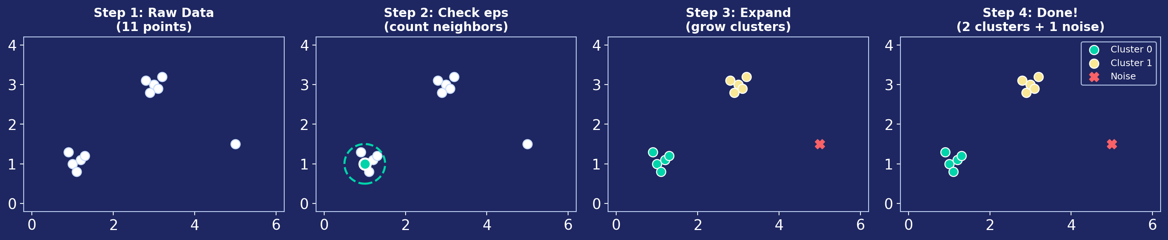
How DBSCAN Works
1
2
3
4
Pick an unvisited point, count neighbors within eps
If count ≥ min_samples → core point, start new cluster
Visit all neighbors; if they're core too, expand further
If count < min_samples → label as noise (may become border later)
CSC564— King Saud University
21

Slide 22
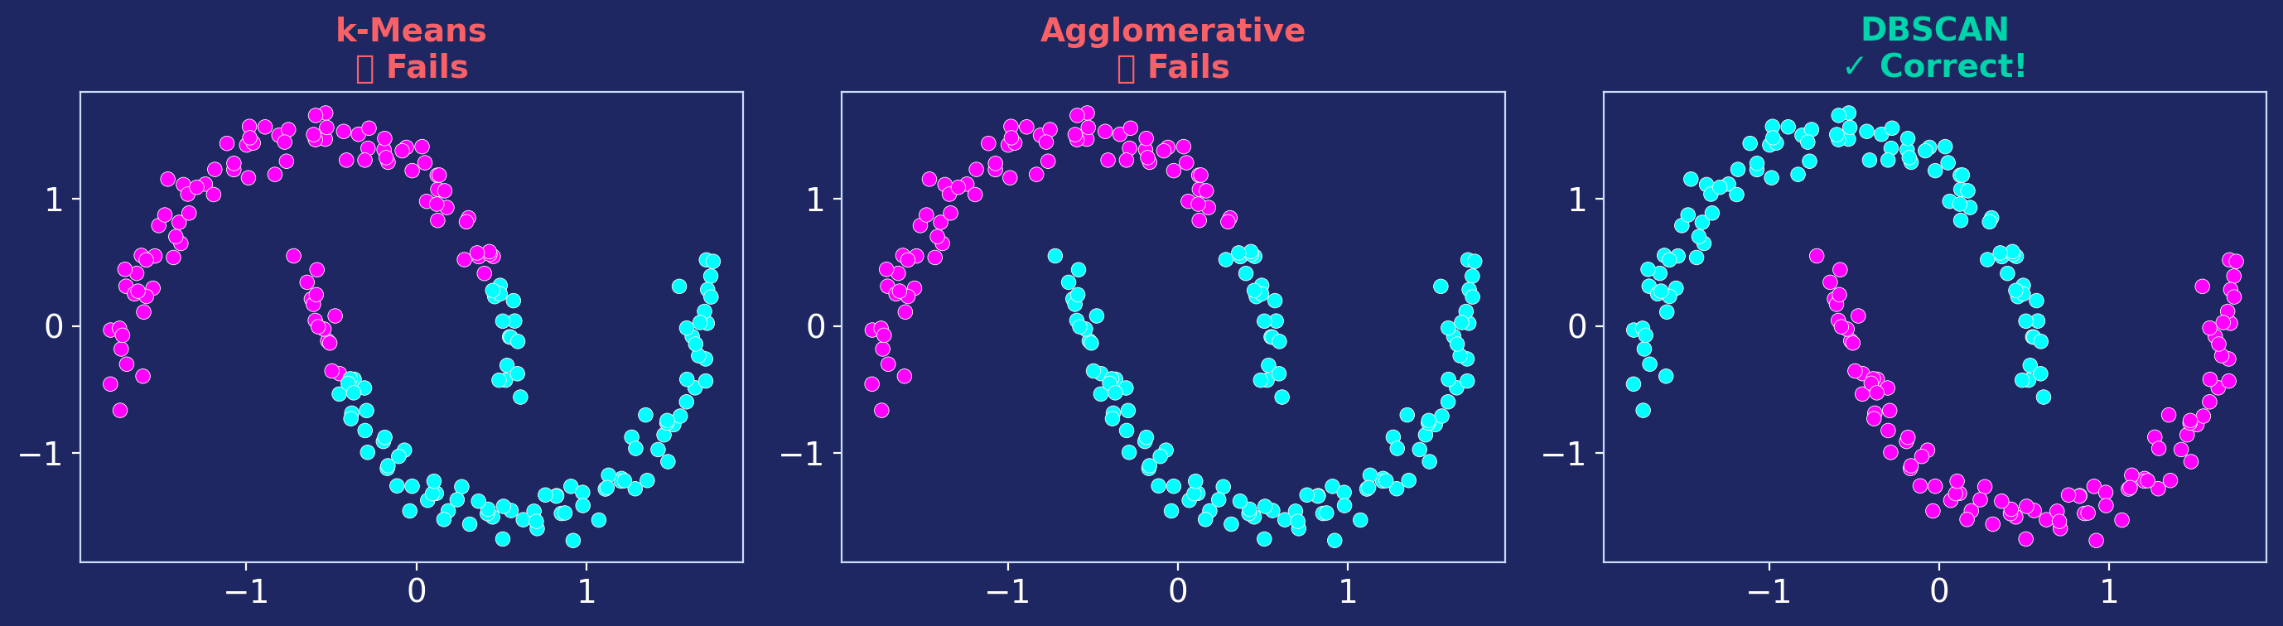
Why Do We Need DBSCAN?
k-Means and Agglomerative both fail on complex shapes
Must pre-set k
How many clusters? You have to guess.
Spherical only
Forces round boundaries — misses crescents, rings.
No noise detection
Every point must belong to a cluster.
CSC564— King Saud University
22

Slide 23
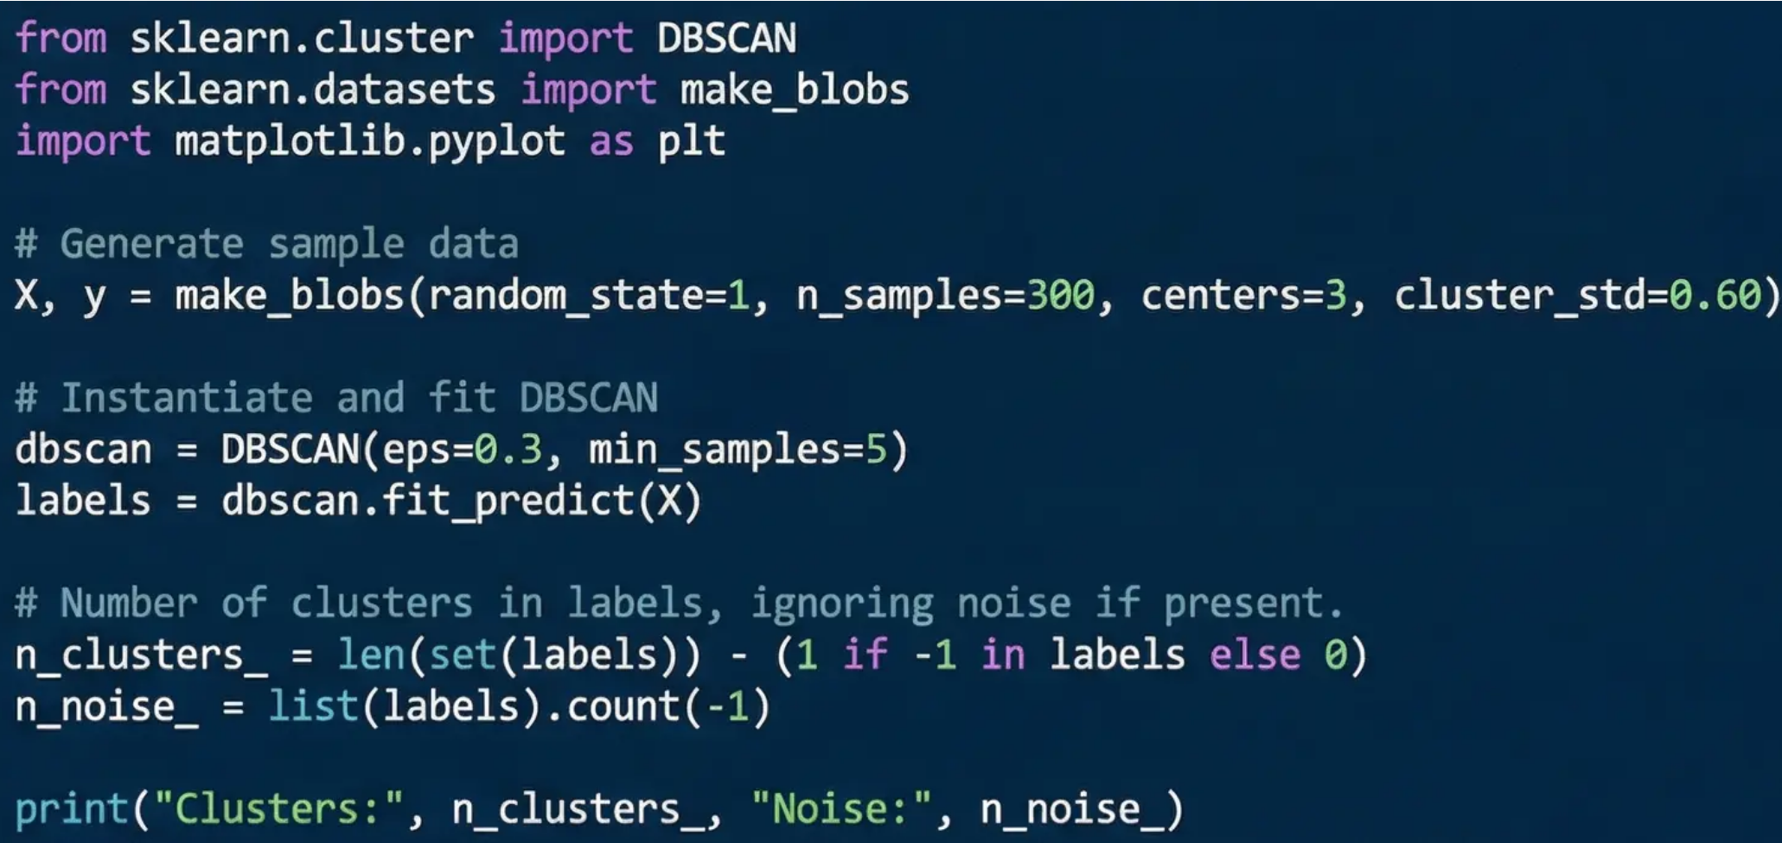
Implementing DBSCAN in Python
Code Example Workflow & Interpretation
• Using scikit-learn's DBSCAN class for simple model fitting • Set parameters eps and min_samples during instantiation • Fit the model to data X and get cluster labels • Cluster labels: -1 represents noise points, other integers are cluster IDs
CSC564— King Saud University
23

Slide 24
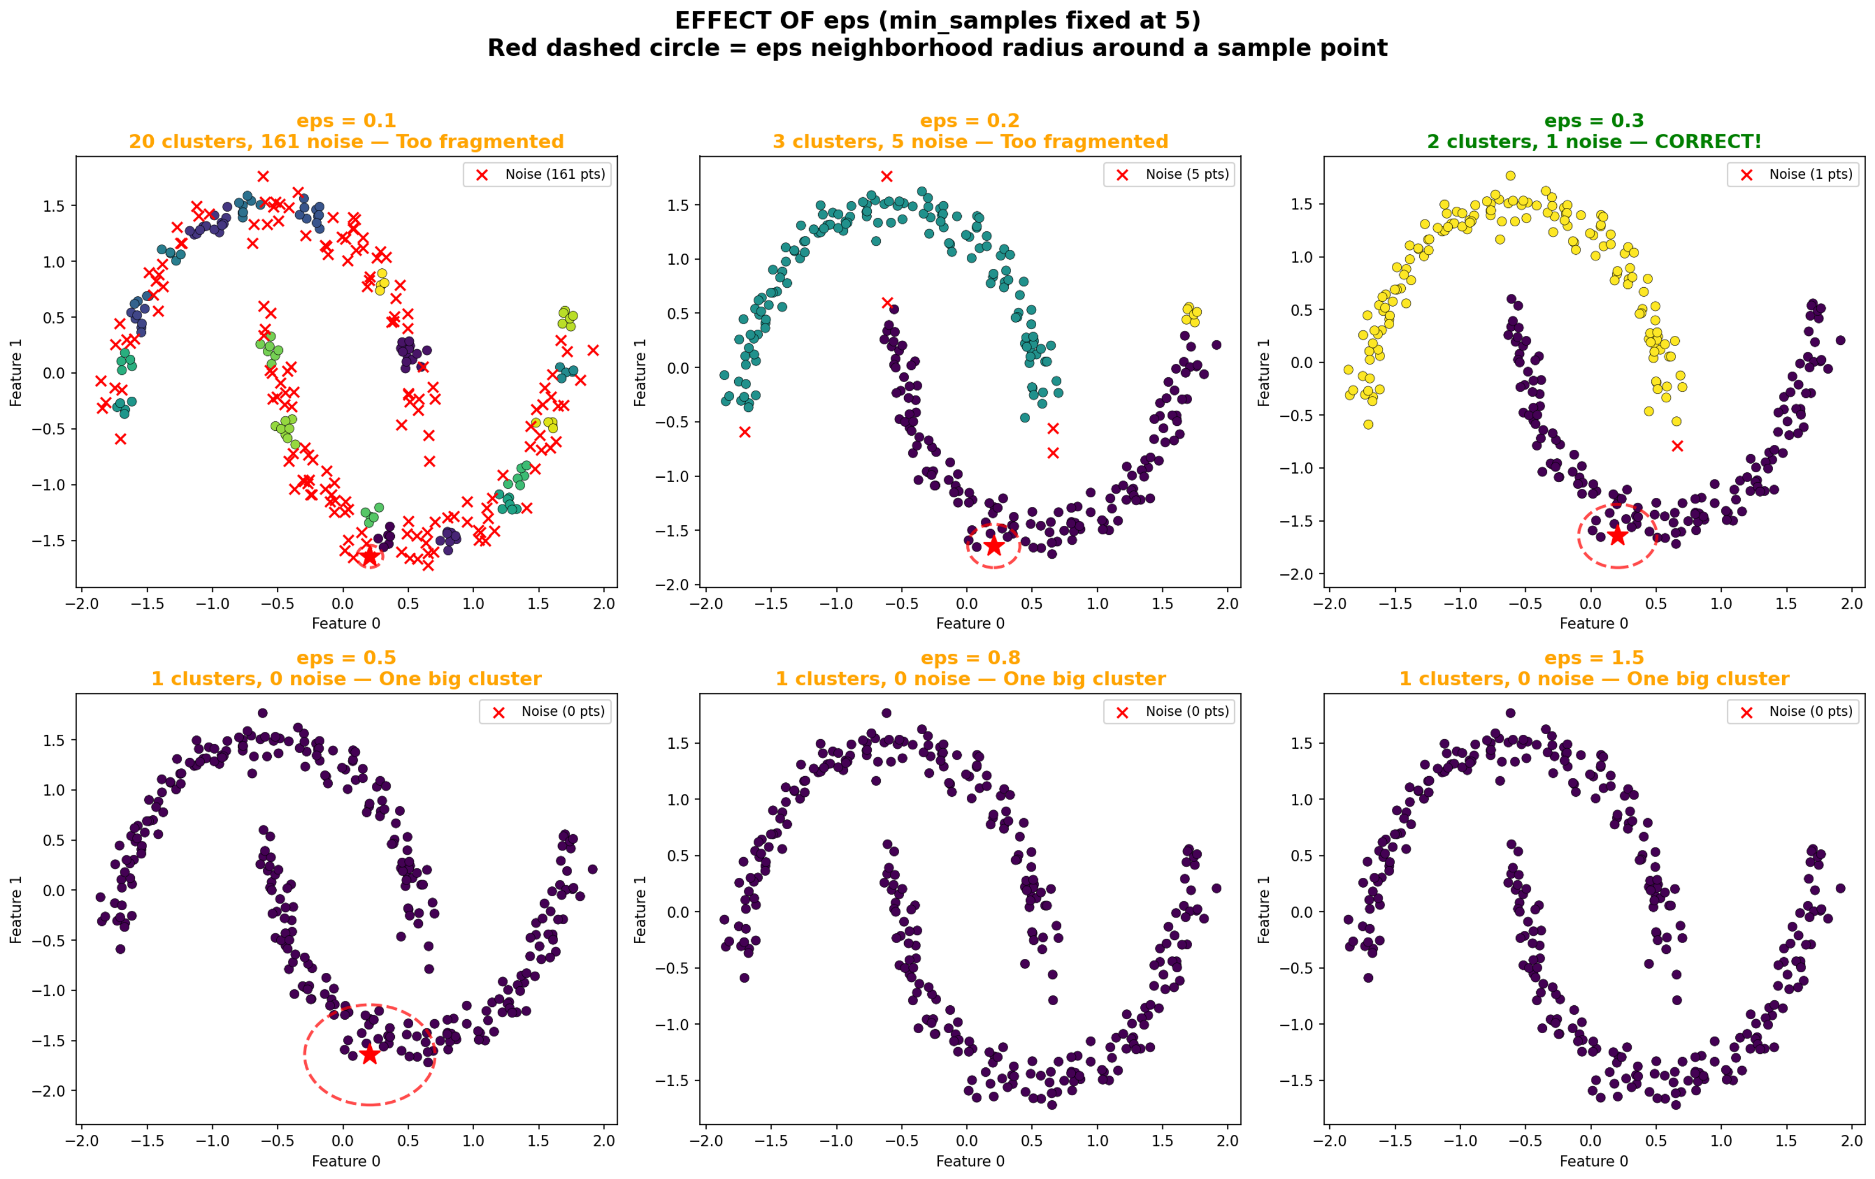
Effect of eps Parameter
Too Small
Neighborhoods too tight → most points become noise
Just Right
Natural clusters emerge with appropriate noise detection
Too Large
Neighborhoods overlap everything → single giant cluster
CSC564— King Saud University
24

Slide 25

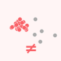




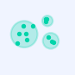

DBSCAN Advantages & Limitations
No k Required
Discovers the number of clusters automatically from the data structure
Varying Densities
Struggles when clusters have very different densities— one eps can't fit all
Noise Detection
Identifies outliers as noise points (label = -1) instead of forcing them into clusters
High Dimensions
Distance becomes less meaningful in manydimensions (curse of dimensionality)
Complex Shapes
Handles crescents, rings, and non-convexclusters that k-Means cannot
Parameter Sensitivity
Results highly sensitive to eps — small changes candramatically alter output
Varying Sizes
Naturally handles clusters of different sizesand densities
No predict()
Cannot assign new data points to existing clusters (no.predict method)
CSC564— King Saud University
25

Slide 26
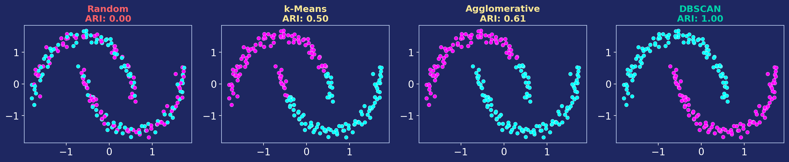
Evaluating Clustering — ARI
Adjusted Rand Index — measures how well clustering matches true labels (0 = random, 1 = perfect)
Key Insight: Why not use accuracy? Cluster labels [0,0,1,1] and [1,1,0,0] are identical groupings but give 0% accuracy. ARI correctly returns 1.0 because it compares groupings, not label numbers.
CSC564— King Saud University
26

Slide 27
Silhouette Score — A Cautionary Tale
Measures cluster compactness and separation (−1 to 1, higher = better)
Algorithm | ARI (with labels) | Silhouette (no labels) | Verdict
k-Means | 0.50 | 0.58 ← Higher! | Visually wrong
DBSCAN | 1.00 | 0.38 | Visually correct ✓
⚠ Why Silhouette Score Can Be Misleading
Silhouette favors compact, spherical clusters — exactly what k-Means produces.
DBSCAN finds the correct complex-shaped clusters but scores lower.
Book's conclusion: No perfect automatic metric. Manual inspection is essential.
CSC564— King Saud University
27

Slide 28
Algorithm Comparison — Strengths & Weaknesses
Feature | k-Means | Agglomerative | DBSCAN
Must set # clusters | Yes | Yes | No ✓
Complex shapes | No | No | Yes ✓
Noise detection | No | No | Yes ✓
Scalability | Excellent ✓ | Good | Good
predict() for new data | Yes ✓ | No | No
Varying densities | Partial | Partial | Struggles
Cluster shapes | Spherical | Spherical | Arbitrary ✓
Key output | Cluster centers | Dendrogram | Core/Border/Noise
Parameters | n_clusters | n_clusters, linkage | eps, min_samples
CSC564 — King Saud University
28

Slide 29
Key Takeaways
1
DBSCAN finds clusters by density, not distance — enabling complex shapes and noise detection
2
eps is the critical parameter — always use StandardScaler first to normalize features
3
No single algorithm wins everything — each reveals different aspects of the data
4
Evaluation metrics can be misleading — Silhouette favors k-Means even when DBSCAN is correct
Live Demo: faresalotaibi888-gif/Clustering: Clustering for AI Master Program → Open in Google Colab
CSC564 — King Saud University
29

Slide 30
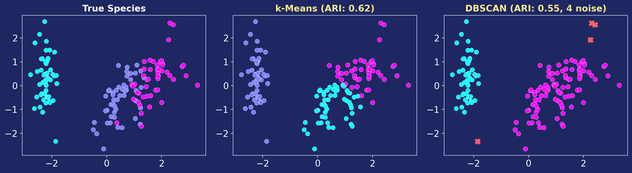
Real-World Demo — Iris Dataset
150 flowers · 4 features · 3 species · Can clustering discover the species?
Insight: k-Means scored higher (ARI: 0.62) by forcing 3 groups. DBSCAN found only 2 natural clusters (ARI: 0.55) because Versicolor and Virginica have no density gap between them. Neither is wrong — they answer different questions.
CSC564— King Saud University
31

Slide 31
Book Example — Faces Dataset (pp. 195–207)
2,063 face images · 100 PCA dimensions · Each algorithm tells a different story
DBSCAN
eps=15 → 1 big cluster + 27 noise
Noise = unusual faces (hats, odd angles, hands covering face)
eps=7 → small clusters of genuinely similar faces
k-Means
10 smooth "average face" centers
Each center shows shared orientation, expression, lighting
Forces even partitions regardless of structure
Agglomerative
Dendrogram shows no natural cut point
Confirms faces form a continuous spectrum
Different groupings than k-Means (low ARI)
Key Takeaway: Face images don't form distinct groups — DBSCAN honestly revealed this.
CSC564— King Saud University
32

